Slide 1
COVID-19 Dashboard: India 2020
Insights and Analysis

Slide 2
Introduction
- Purpose of these Dashboards: - To analyze the impact of COVID-19 in India throughout 2020.
- Importance: - Provides insights into case trends, recovery rates, and testing data.

Slide 3
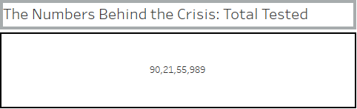
Dashboard 1: COVID-19 Overview in India (2020)
Visuals in Dashboard
1) The Numbers Behind the Crisis: Total Tested
- Description: This visual displays the total number of COVID-19 tests conducted across India throughout the year 2020.
- Purpose: It provides a snapshot of the testing efforts undertaken in the country. High testing numbers indicate a proactive approach to identifying and managing the virus's spread.
- Insights: Observing trends over time can reveal the impact of government policies and public health initiatives on testing rates.

Slide 4
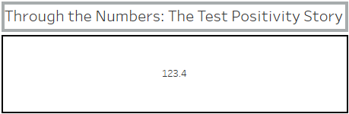
2) Through the Numbers: The Test Positivity Story
- Description: This card shows the rate of tests that returned positive results.
- Purpose: The positivity rate is a crucial indicator of the virus's spread; a high positivity rate may suggest insufficient testing relative to the spread of the virus.
- Insights: Trends in positivity rates help assess the effectiveness of testing strategies and public health measures. A rising positivity rate may signal an increase in infections.

Slide 5
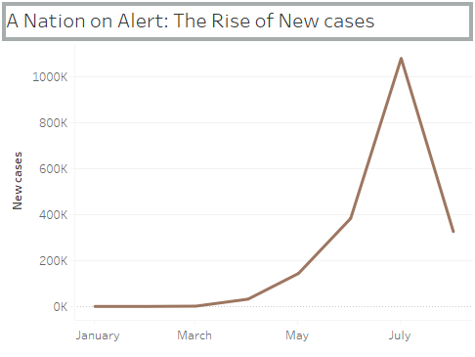
3) A Nation on Alert: The Rise of New cases
- Description: This line chart illustrates the number of new COVID-19 cases reported in India throughout 2020.
- Purpose: It visualizes the fluctuations in new cases over time, helping identify peaks and troughs in the pandemic.
- Insights: Analyzing spikes can correlate with specific events, policy changes, or social behaviors, providing context for public health responses.

Slide 6
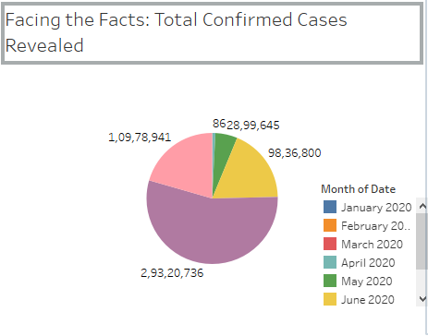
4) Facing the Facts: Total Confirmed Cases Revealed
- Description: This pie chart shows the proportion of total confirmed COVID-19 cases relative to the total number of tests conducted.
- Purpose: It helps to visualize the overall scale of the pandemic and the impact of testing.
- Insights: A large proportion of confirmed cases indicates a significant outbreak, while a smaller proportion suggests better control of the virus.

Slide 7

5)State Filter:
- Description: This interactive filter allows users to select a specific state to view data pertaining only to that state.
- Purpose: It enhances user engagement and allows for tailored insights based on geographical focus
- Insights: Enables comparison between states and identification of regional patterns in testing and case numbers.

Slide 8
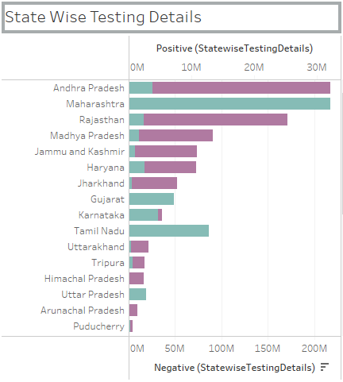
Dashboard 2: State-wise Testing Details
Visuals In Dashboard
1) Bar Chart - State Wise Testing Details
- Description: This dual-axis bar chart displays state-wise positive and negative COVID-19 test results. - Purpose: It allows for an easy comparison of the number of positive cases against the number of negative tests in each state. - Insights: By comparing these figures, one can assess the testing efficacy and the state’s COVID-19 burden, identifying which states may need additional resources.

Slide 9
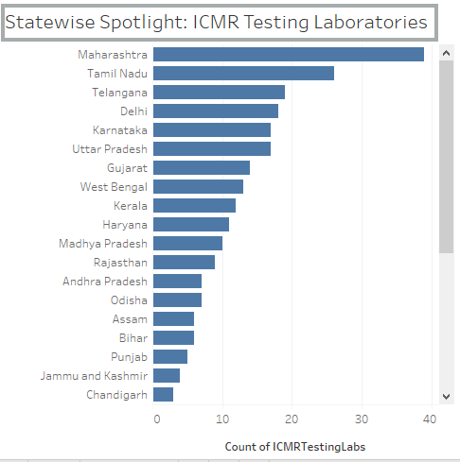
2) Bar Chart - Statewise Spotlight: ICMR Testing Laboratories
- Description: This bar chart shows the count of ICMR (Indian Council of Medical Research) testing labs available in each state.
- Purpose: It provides insights into the capacity for testing across different regions.
- Insights: States with fewer labs may face challenges in testing capacity, which can correlate with higher positivity rates and case counts.

Slide 10
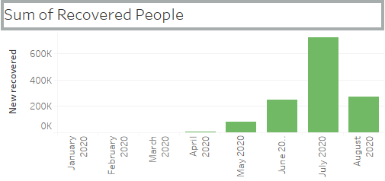
Dashboard 3: Recovery and Mortality Insights
Visuals In Dashboard
1)Bar Chart - Counting Hope: The Sum of Recovered Lives
- Description: This bar chart displays the total number of recovered COVID-19 patients across India throughout 2020.
- Purpose: It highlights the recovery trends in relation to overall case counts.
- Insights: High recovery numbers can indicate effective treatment and healthcare responses, fostering public confidence in managing the pandemic.

Slide 11
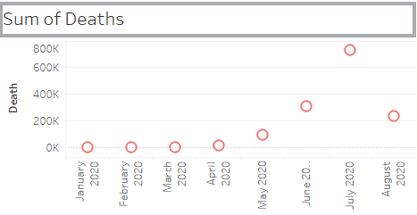
2)Circle Chart - Counting Loss: The Sum of Lives Lost
- Description: This circle view chart represents the total number of deaths attributed to COVID-19 in India throughout 2020.
- Purpose: It visually communicates the impact of the pandemic on mortality rates.
- Insights: Comparing this data with recovery numbers can provide insights into the overall severity of the outbreak in different states.

Slide 12
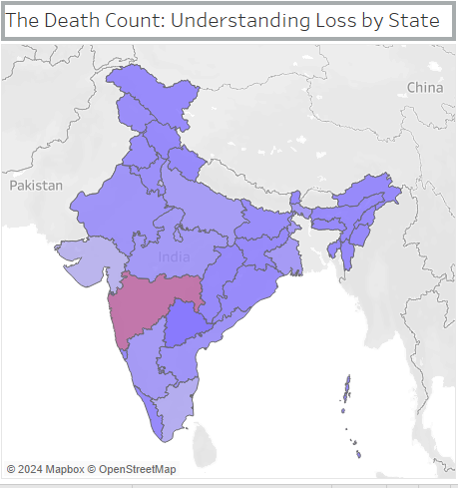
3)Map Chart - The Death Count: Understanding Loss by State
Description: This map visualizes the total COVID-19 deaths by state.
Purpose: It provides a geographical perspective on the pandemic's impact, allowing for quick identification of hotspots.
Insights: This interactivity enables deeper analysis and regional comparisons, aiding in resource allocation and targeted interventions.

Slide 13
Action Filter on Map Visual
- Description: The action filter on the map allows users to click on a state to update related visuals, creating an interactive experience.
- Purpose: Interactive feature allowing selection of states to filter other visuals.
- Insights: Enhances analytical depth by enabling localized analysis of trends and outcomes, making data exploration more intuitive.

Slide 14
Conclusion:
In conclusion, the dashboards offer an insightful and thorough examination of the COVID-19 pandemic in India throughout 2020. By illustrating essential metrics like testing numbers, positivity rates, recoveries, and deaths, these visuals provide a clear narrative of the pandemic's progression. The interactivity enhances user engagement, allowing for tailored analysis of state-specific data. These insights are crucial for informing public health strategies and improving response efforts, ensuring that we are better prepared for any future health crises.

Slide 15
Thank You

